Slide 1
CS626: Hate speech detector Final Project discussion
Desai Divyeshwar Reddy, 200050033
Kajal , 200050056
Reddy Bhavana, 200050117
Nov 27, 2022
Notes:
1

Slide 2
Problem Statement
Given the dataset for training , we have to build a hate speech detector using deep learning which, given a test sentence will classify the sentence in on of two categories (Hate and normal)
It will also specify which class (based on race, ethnicity, national origin, religion, sex, gender, sexual orientation, disabilityor disease) is being targeted in the sentence.

Slide 3
Related works
B. Mathew, P. Saha, S. M. Yimam, C. Biemann, P. Goyal, and A. Mukherjee. Hatexplain: A benchmark dataset for explainable hate speech detection. In
Proceedings of the AAAI Conference on Artificial Intelligence, volume 35, pages 14867–14875, 2021.
Link : https://www.researchgate.net/publication/340643958_Deep_Learning_Models_for_Multilingual_Hate_Speech_Detection
Gaurav Rajput, Narinder Singh punn, Sanjay Kumar Sonbhadra, and Sonali
Agarwal
Indian Institute of Information Technology, Allahabad, Uttar Pradesh 211015, India
Link : https://arxiv.org/pdf/2106.15537v1.pdf
Notes:
3

Slide 4
Dataset (s)
English Datasets :
https://github.com/bvidgen/Dynamically-Generated-Hate-Speech-Dataset
https://huggingface.co/datasets/ucberkeley-dlab/measuring-hate-speech
In datset 2 , it includes 8 target groups(race/ethnicity, religion, national origin/citizenship, gender, sexual orientation, age, disability, political ideology) and 42 subgroups but we only took groups
Pre Processing of data: For pre processing we convert the data into lower case and removing the unnecessary words and stop words and extra space
After Pre processing the data we tokenize the sentence and we will do padding
After padding we convert word to vector using word2vec model in genism library

Slide 5
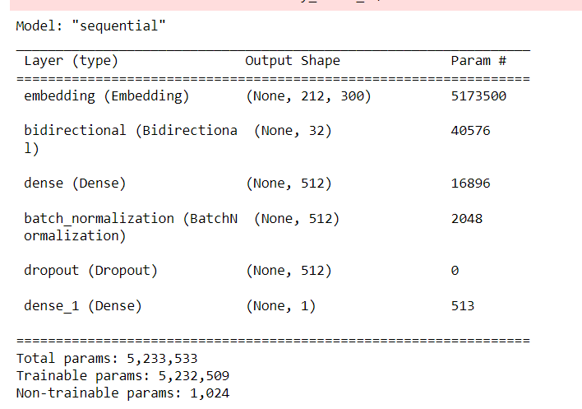
WorkFlow,Architecture,Technique
Implemented sequential layers using keras library and the loss function for classification whether it is hate or not hate is using binary cross entropy and adams optimizer with learning rate as 0.005
For multiclass target classification we use loss function as categorical cross entropy and adams optimizer with learning rate 0.0005

Slide 6
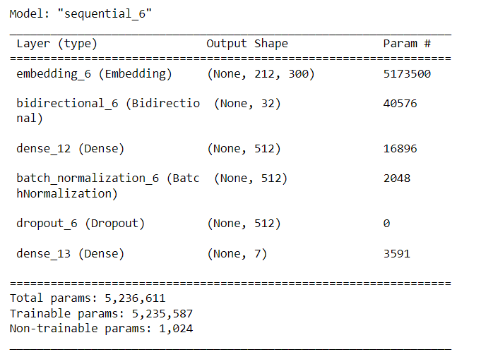
WorkFlow,Architecture,Technique
We use bidirectional layer and dense layer and batch normalization for implementing a model
For hate or not hate last layer is sigmoid where the neuron classifies hate when probability is more than 0.5 else not hate where as for last layers also we use sigmoid instead of softmax because we want to predict more than one target class

Slide 7
Results and Analysis
Precision :0.590
Recall:0.673
Confusion Matrix:
Here accuracy , precision, recall is very low because for word to vector we are using word2vec
If we use laser model and bert the accuracy will increase
Most if the sentences it is giving as hate
 | Actual Hate | Actual N-Hate
Pred Hate | 2565 | 1261
Pred N-hate | 1805 | 2598

Slide 8
Demo
For we write a function sentovec which will convert input sentence into vector
This function first preprocess the sentence and tokenize the sentence and done padding and convert into word2vector
These list is ready for predicting , we load a already saved model and using predict function we predict that
Output Interpretation:
If output is less than 0.5 it is not hate else it is hate and similarly for multi label class if the neuron corresponding to class less than 0.5 then the given sentence wont target that class else it will target that class

